Slide 1
Adding Intelligence to your Apps with Computer Vision
Brian Sherwin
Technical Evangelist
Brian.Sherwin@Microsoft.com
@bsherwin

Slide 2
Is this not the most exciting time to be a developer?

Slide 3

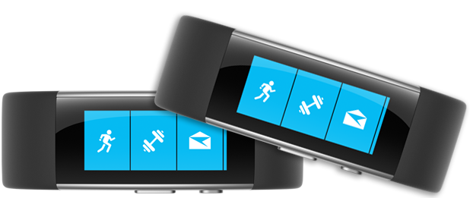
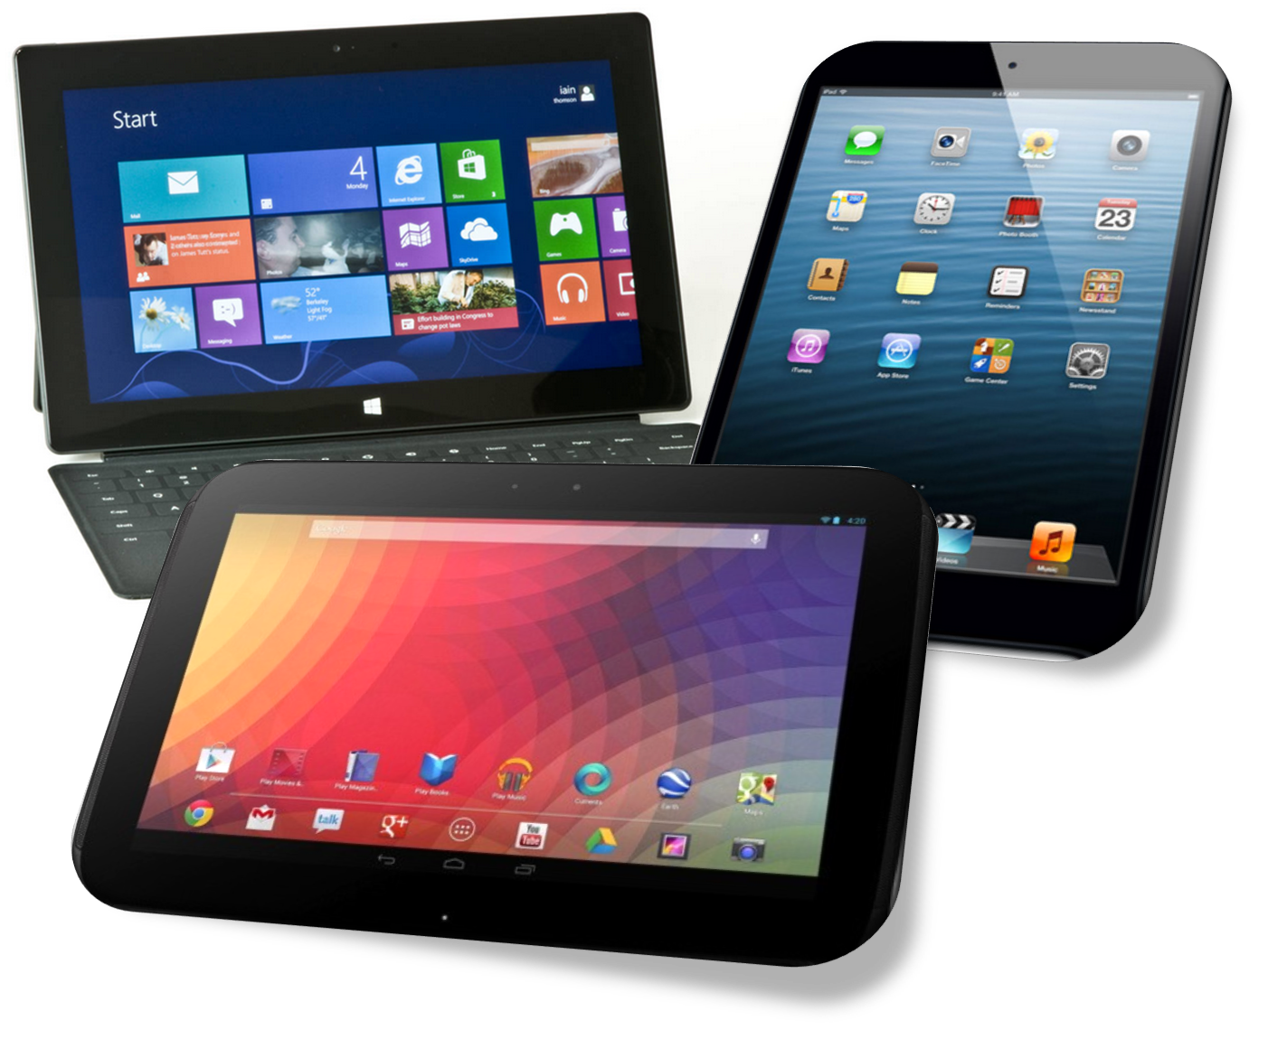

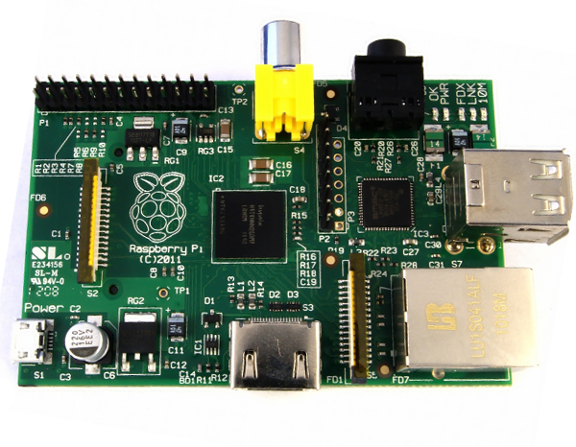
How we develop apps…
Clients
Wearables
Phones
Tablets
PCs
Headsets
Compute
Microcontroller
Global Scale Super Compute

Slide 4

Cognitive Services
Microsoft Cognitive Services
Give your apps a human side
Enable natural and contextual interaction with tools that augment users' experiences via the power of machine-based AI.
Vision
From faces to feelings, allow your apps to understand images and video
Speech
Hear and speak to your users by filtering noise, identifying speakers, and understanding intent
Language
Process text and learn how to recognize what users want
Knowledge
Tap into rich knowledge amassed from the web, academia, or your own data
Search
Access billions of web pages, images, videos, and news with the power of Bing APIs

Slide 5

Cognitive Services
microsoft.com/cognitive
Vision
Speech
Language
Knowledge
Search
Computer Vision
Custom Recognition
Bing Spell Check
Academic Knowledge
Bing
Web Search
Emotion
Speaker Recognition
Linguistic Analysis
Entity Linking
Bing
Image Search
Face
Speech
Language Understanding
Knowledge Exploration
Bing
Video Search
Video
Translator
Text Analytics
Recommendations
Bing
News Search
WebLM
Bing
Autosuggest

Slide 6







Why Microsoft Cognitive Services ?
Easy
Flexible
Tested
Roll your own with REST APIs
Simple to add: just a few lines of code required
Make the same API code call on iOS, Android, and Windows
Integrate into the language and platform of your choice
Built by experts in their field from Microsoft Research, Bing, and Azure Machine Learning
Quality documentation, sample code, and community support
GET A KEY
BUILD

Slide 7

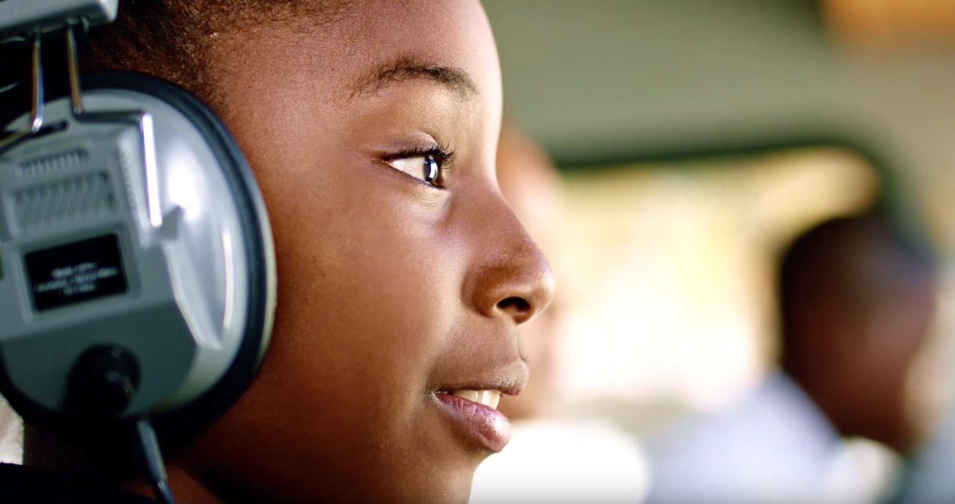
What’s in a video?
People
Image type
Identity
Age
Text
Audio
Gender
Emotion
Related Content
Entities
Image color
Vocabulary

Slide 8








Analyze image
Vision APIs
Category | People; 1 face found
Adult / Racy? | False / True
Black & White? | No
Dominant colors
Accent color
Analyze an Image – Understand content and features within an image for a growing set of categorization
Wide range of concepts from cat to fireworks
OCR – Detect and recognize words within photos or scanned documents
Generate Thumbnail – Scale and crop an image, while retaining key content
Powers Bing Image search and OneDrive.com Photos
OCR
Recognized text:
A GOAL WITHOUT
A PLAN IS
JUST A WISH
Smart thumbnail
Notes:
Examples – Useful for moderating UGC

Slide 9


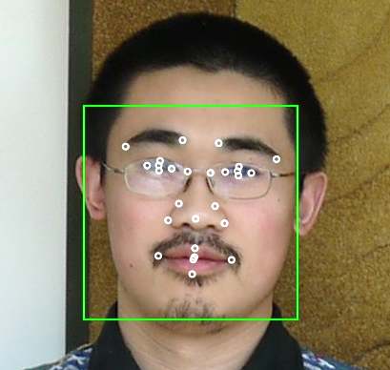


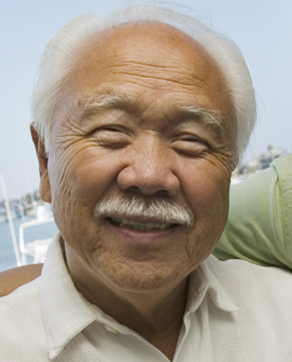



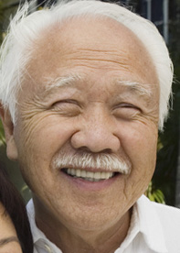


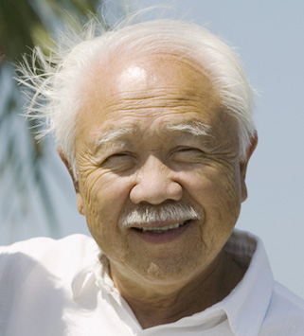





Detection Result
Face APIs
Face Rectangle – width; height; left; top
Attributes:
Age – 31
Gender – Male
Face Landmarks –pupil, nose, mouth
DETECTION
ATTRIBUTES
INPUT IMAGE
Face Detection – Detects faces and their attributes within an image
Face Verification – Check if two faces belong to the same person
Similar Face Searching – Find similar faces within a set of images
Face Grouping – Organize many faces into groups
Face Identification – Search which person a face belongs to
Models used to power Microsoft Skype & Windows Hello
Grouping
Identity
He is Chao Wang…
IDENTIFY
Natalie Huber
NEW INPUT IMAGE
RECOGNITION
Chao Wang
COLLEAGUES

Slide 10


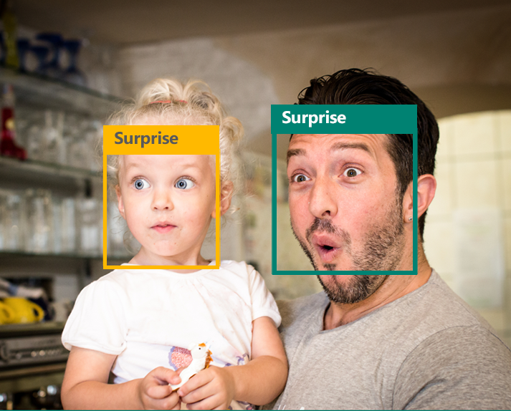
Emotion APIs
Identifies emotions based on expressions that psychologic research identifies as universal: Happiness, Surprise, Sadness, Anger, Fear, and Disgust
Has been trained to identify emotions in-the-wild.
A solution for analyzing individual responses to media and products, to crowd analytics, and to enhanced personalization
Get insights into how your users react to content and experiences
Track facial expressions for multiple users over time.

Slide 11
Seeing AI
https://www.youtube.com/watch?v=R2mC-NUAmMk

Slide 12
Demo Code
http://github.com/dwcares/DragonDrone
Raspberry pi code included in this repo.

Slide 13
We need to move on from Artificial Intelligence trying to beat humans and move to a place with it helps humans by solving very complex problems much faster than we can.

Slide 14
Brian.Sherwin@Microsoft.com
@bsherwin
linkedin.com/in/bsherwin

